Slide 1
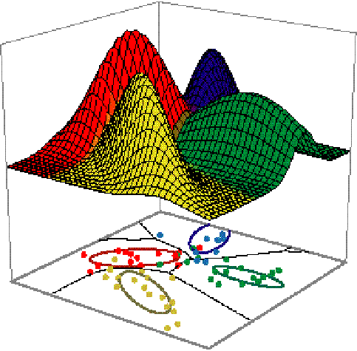

Slide 2
Bayes Optimal Classifier

Slide 3
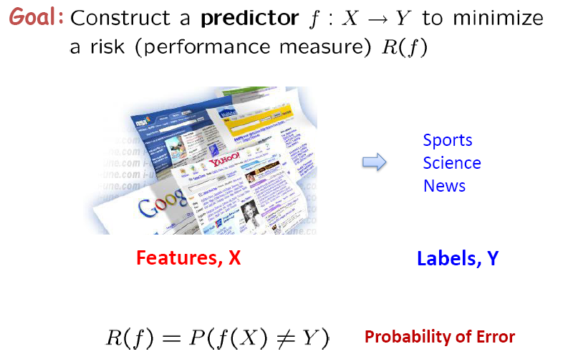
Classification

Slide 4
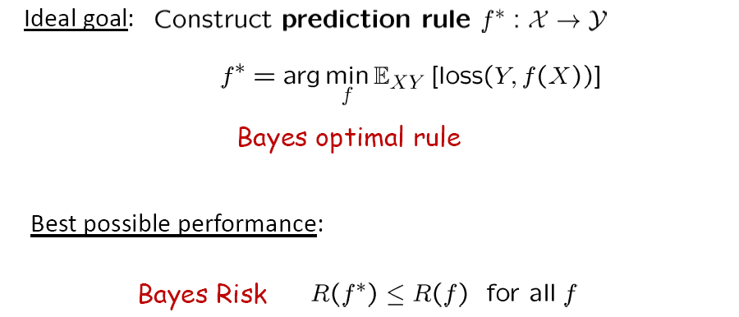

Bayes optimal rule

Slide 5
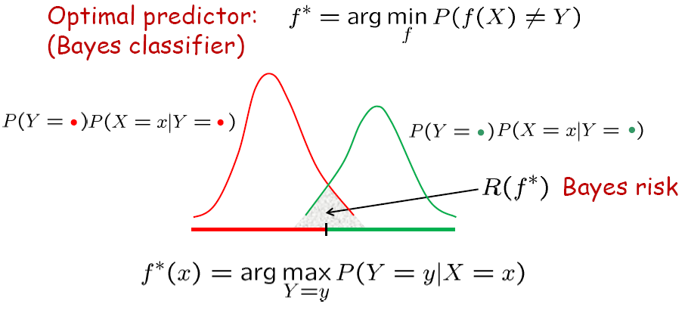
Optimal Classification

Slide 6
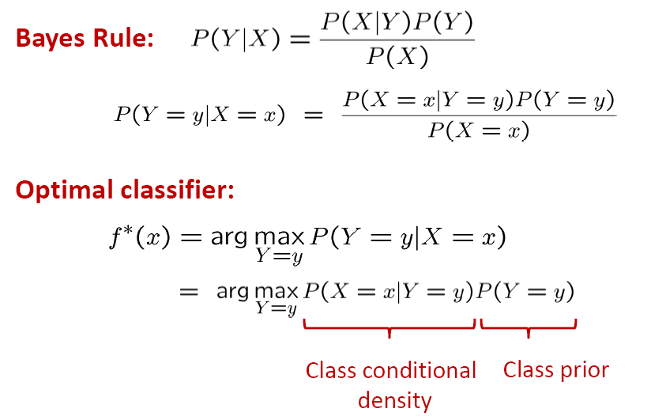
Optimal Classifier

Slide 7
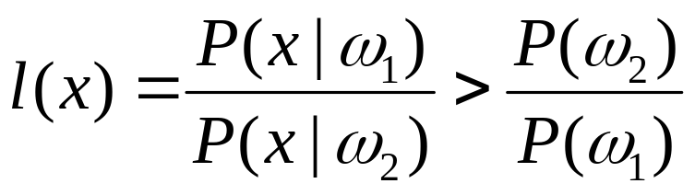
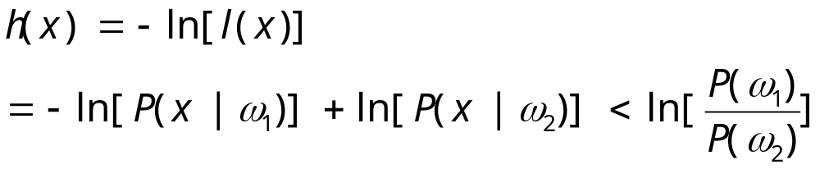
Equivalent Rules
If P(ω₁ | x) > P(ω₂ | x) , ω = ω₁
If P(x | ω₁) P (ω₁) > P(x | ω₂) P (ω₂) , ω = ω₁
If , ω = ω₁
If

Slide 8
Example
P(ω₁)=0.9， P(ω₂)=0.1
P(x | ω₁)=0.2， P(x | ω₂)=0.4，
x ? ω₁ or ω₂

Slide 9
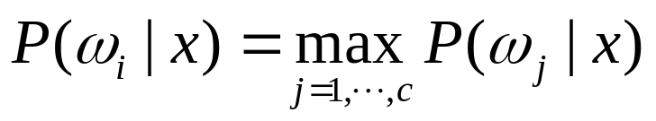
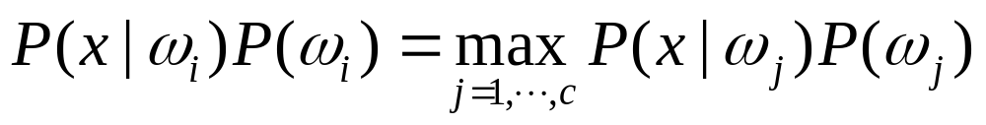
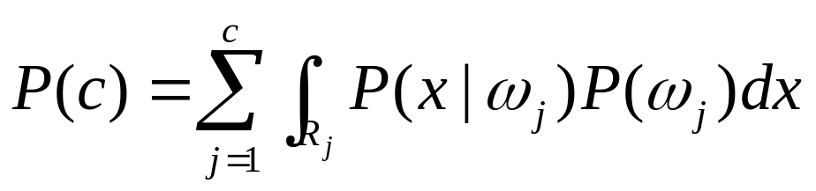
For C classes
If , , ω = ω_{i}
If , ω = ω_{i}
P(e)=1-P(c)

Slide 10
Optimal Classification

Slide 11
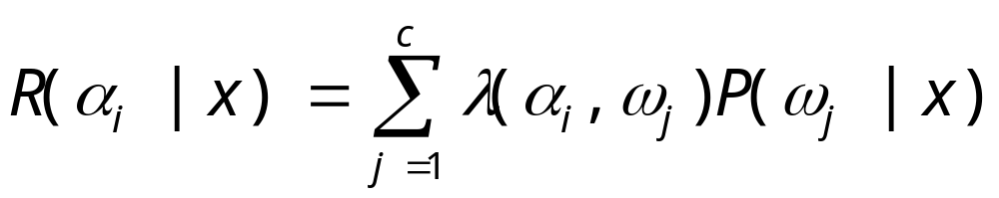
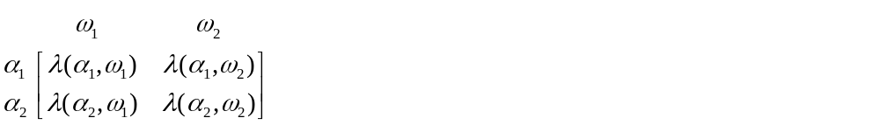
Mini Risk-based Bayes
If R(α₁ | x) < R(α₂ | x) ， α = α₁
If (λ₂₁ - λ₁₁)P(ω₁ | x)
> (λ₁₂ - λ₂₂)P(ω₂ | x) ，α = α₁

Slide 12
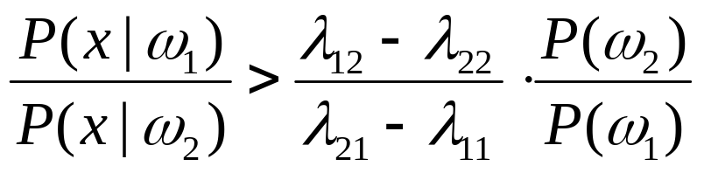

Mini Risk-based Bayes
If (λ₂₁ - λ₁₁)P(x | ω₁) P (ω₁)
> (λ₁₂ - λ₂₂)P(x | ω₂) P (ω₂) ， α = α₁
If ， α = α₁

Slide 13
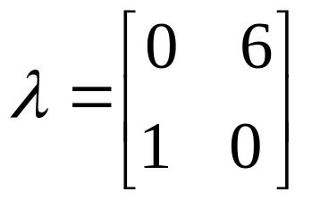
Example
P (ω₁ )=0.9，P (ω₂ )=0.1
P(x | ω₁)=0.2，P(x | ω₁)=0.4
x ? ω₁ or ω₂

Slide 14
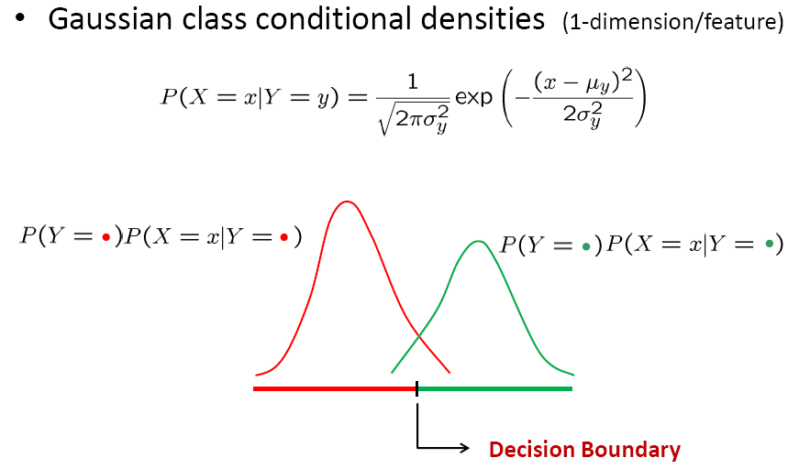
Example: 1-d Decision Boundaries

Slide 15
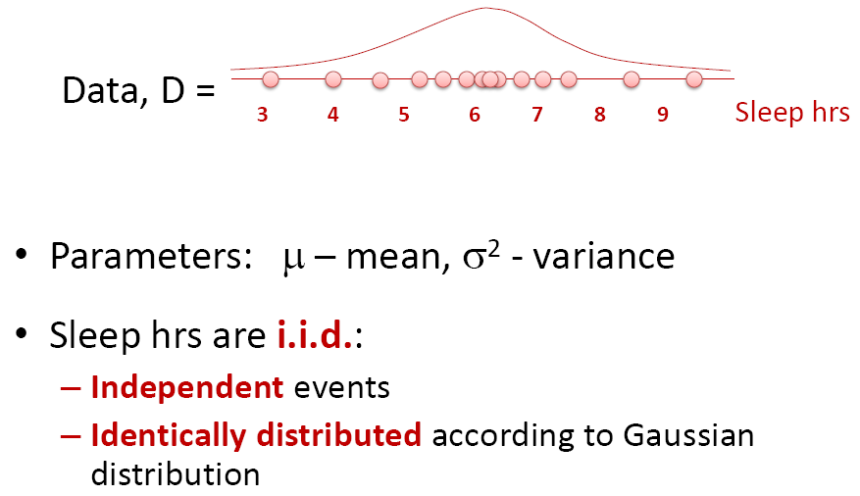
Gaussian Distribution

Slide 16
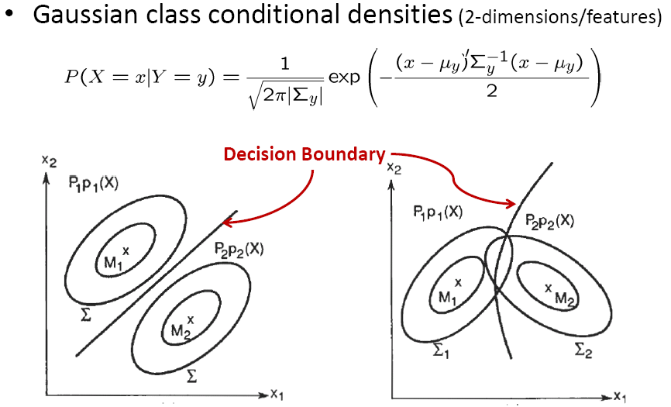
Example: 2-d Decision Boundaries

Slide 17
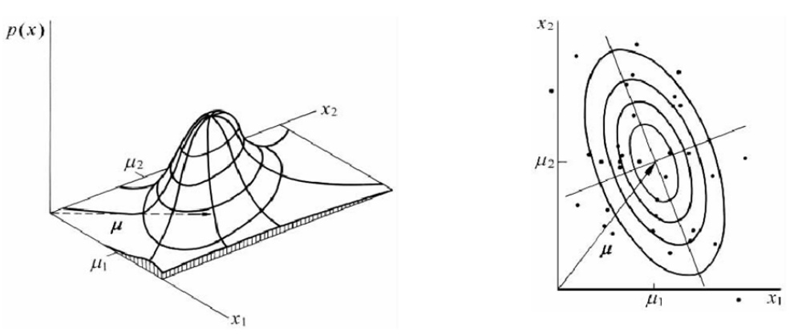
Properties of Multivariate Gaussian (I)
P(x) ～N(μ, Σ )

Slide 18
Properties of Multivariate Gaussian (II)
hyper-elliptical surface of constant probability density for a Gaussian, i.e. (x-μ)^{t} Σ⁻¹(x-μ)=constant
Noncorrelation=independence
Marginal distribution is Gaussian
Conditional distribution is also Gaussian
Linear transformation is still Gaussian
Linear combination is still Gaussian

Slide 19
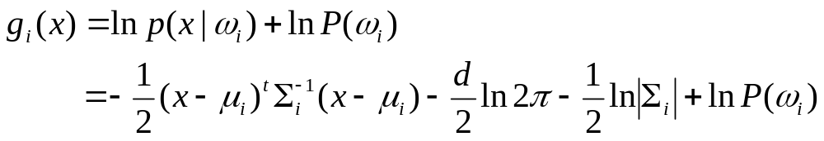
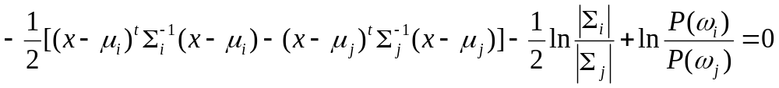
Discriminant function and decision boundary
Discriminant function
Decision boundary g_{i}(x) = g_{j}(x)
i.e.

Slide 20
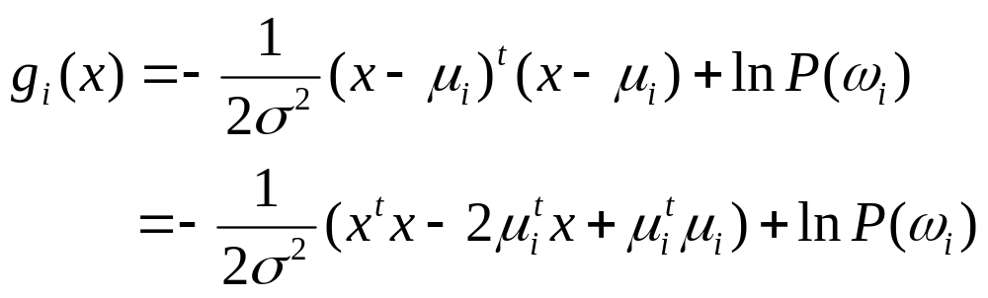
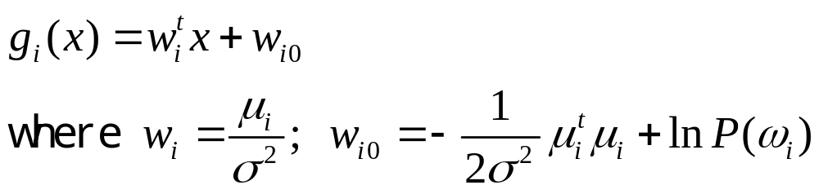
Case 1: Σ_{i} = σ²I
Linear discriminant function:
  It is a function that is a linear combination of the components of x
where w is the weight vector and w₀ the bias

Slide 21
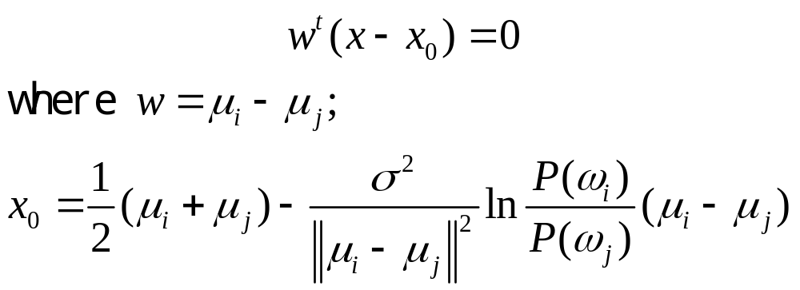
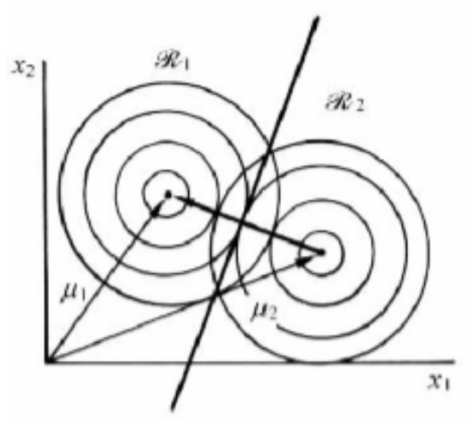
Decision boundary:
P (ω_{i} )= P (ω_{j} )
P (ω_{i} )≠ P (ω_{j} )

Slide 22
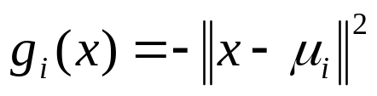
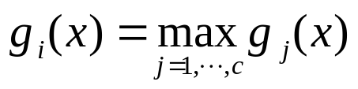
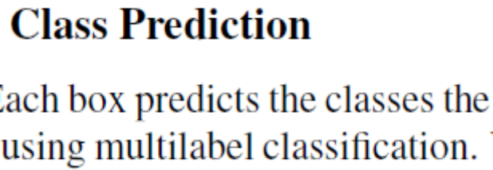
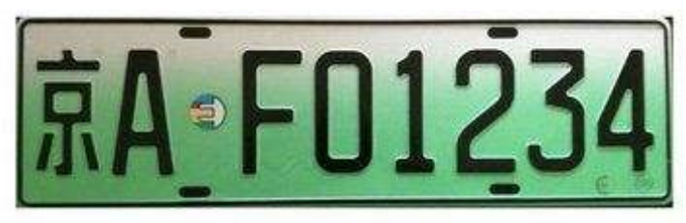
Minimum distance classifier
Discriminant function:
ω = ω_{i}
Each mean vector is thought of as being an ideal prototype or template for patterns in its class (template-matching procedure)

Slide 23
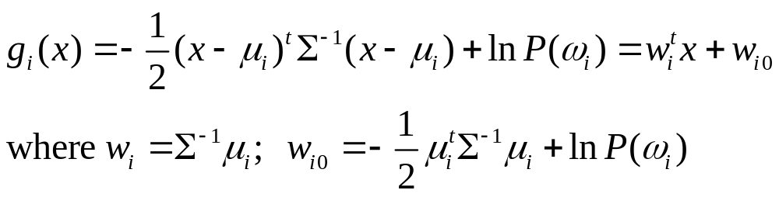
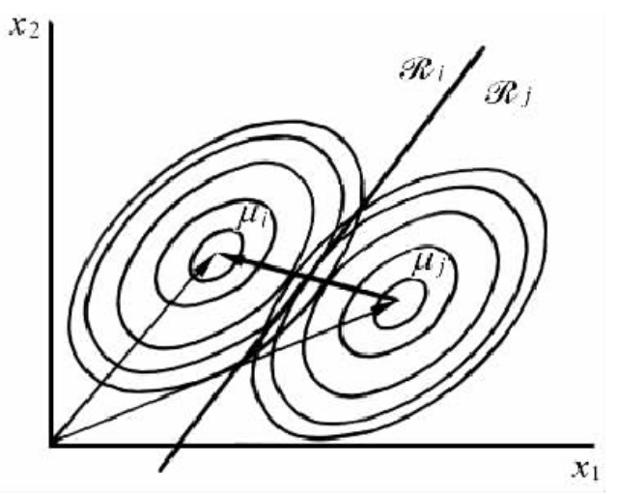
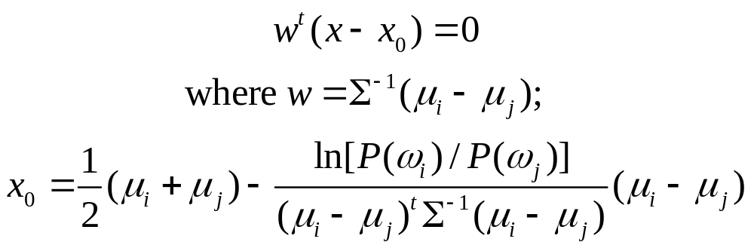
Case 2: Σ_{i} = Σ
Linear discriminant function:
Decision boundary:

Slide 24
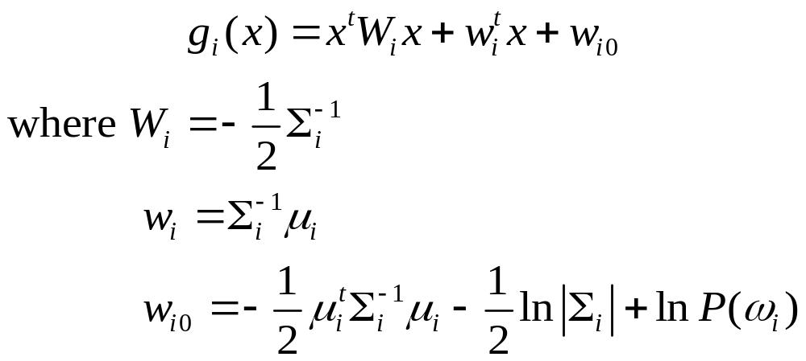
Case 3: Σ_{i} ≠ Σ_{j}
Discriminant function:
Decision boundary:

Slide 25
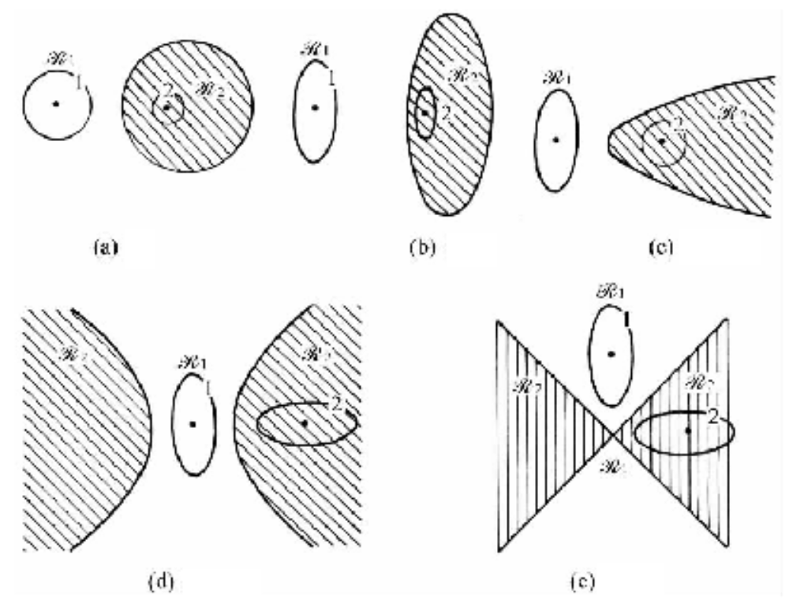


Slide 26
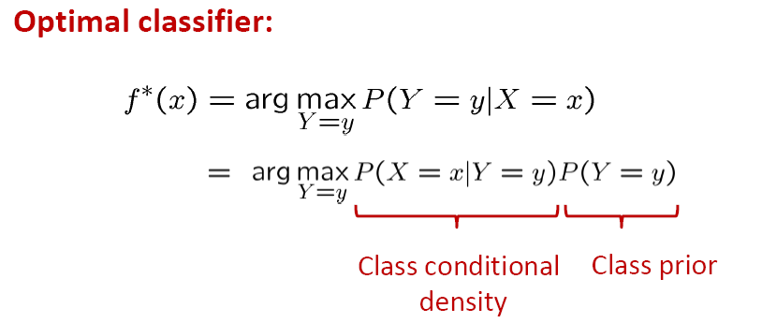
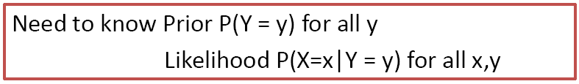
Parameters Learning

